Slide 1
Communicating in Teams

Slide 2

Overview of Teams
Advantages
Disadvantages
Increased information
Broad knowledge base
Diversity of views
Acceptance of solutions
Performance levels
Groupthink
Peer pressure
Hidden agendas
Free riders
High costs
Notes:
Team decision making can benefit an organization by delivering the following benefits:
Increased information and knowledge. By aggregating the resources of several individuals, teams bring more information to the decision process.
Increased diversity of views. Team members bring a variety of perspectives to the decision process.
Increased acceptance of solutions. Those who participate in decision making are more likely to support the decision and encourage others to accept it.
Higher performance levels. Working in teams can unleash vast amounts of creativity and energy in workers who share a sense of purpose and mutual accountability.
Teamwork also has a number of disadvantages:
A team may develop groupthink, the willingness of individual members to set aside their personal opinions and go along with the rest of the team members, even if they are wrong.
Some team members may have a hidden agenda—private motives that affect the group’s interaction.
Other team members may be free riders—those who don’t contribute their fair share to the group’s activities because they aren’t held individually accountable for their work.
Still another drawback to teamwork is the high cost of coordinating group activities. Aligning schedules, arranging meetings, and coordinating a project can eat up a lot of time and money.

Slide 3
Overview of Teams
Team decision making can benefit an organization by delivering the following benefits:
Increased information and knowledge. By aggregating the resources of several individuals, teams bring more information to the decision process.
Increased diversity of views. Team members bring a variety of perspectives to the decision process.
Increased acceptance of solutions. Those who participate in decision making are more likely to support the decision and encourage others to accept it.
Higher performance levels. Working in teams can unleash vast amounts of creativity and energy in workers who share a sense of purpose and mutual accountability.
Teamwork also has a number of disadvantages:
A team may develop groupthink, the willingness of individual members to set aside their personal opinions and go along with the rest of the team members, even if they are wrong.
Some team members may have a hidden agenda—private motives that affect the group’s interaction.
Other team members may be free riders—those who don’t contribute their fair share to the group’s activities because they aren’t held individually accountable for their work.
Still another drawback to teamwork is the high cost of coordinating group activities. Aligning schedules, arranging meetings, and coordinating a project can eat up a lot of time and money.

Slide 4
Improving Your Performance in Teams
Formal
Informal
Permanent Committees
Task Forces and
Problem-Solving Teams
Plan strategy
Review results
Handle employee issues
Solve problems
Handle specific issues
Encourage participation
Notes:
A team is a unit of two or more people who share a mission and the responsibility for working to achieve their goal.
Organizations establish several different types of teams, and each type may communicate a little differently. Companies can create formal teams that become part of the organization’s structure, or they can establish informal teams, which aren’t part of the formal organization but are formed to solve a problem, work on a specific activity, or encourage employee participation. Some teams stay together for years; others may meet their goals in just a few days and then disband.
Problem-solving teams and task forces are informal teams that assemble to resolve specific issues and then disband once their goal has been accomplished.
Committees are formal teams that usually have a long life span and can become a permanent part of the organizational structure. Committees typically deal with regularly recurring tasks. For example, an executive committee may meet monthly to plan strategy and review results, and a grievance committee may be formed as a permanent resource for handling employee complaints and concerns.
You and your fellow team members must be able to communicate effectively with each other and with people outside your team: sharing information with team members, listening carefully to their inputs, and crafting messages that reflect the team's collective ideas and opinions.

Slide 5
Improving Your Performance in Teams
A team is a unit of two or more people who share a mission and the responsibility for working to achieve their goal.
Organizations establish several different types of teams, and each type may communicate a little differently. Companies can create formal teams that become part of the organization’s structure, or they can establish informal teams, which aren’t part of the formal organization but are formed to solve a problem, work on a specific activity, or encourage employee participation. Some teams stay together for years; others may meet their goals in just a few days and then disband.
Problem-solving teams and task forces are informal teams that assemble to resolve specific issues and then disband once their goal has been accomplished.
Committees are formal teams that usually have a long life span and can become a permanent part of the organizational structure. Committees typically deal with regularly recurring tasks. For example, an executive committee may meet monthly to plan strategy and review results, and a grievance committee may be formed as a permanent resource for handling employee complaints and concerns.
You and your fellow team members must be able to communicate effectively with each other and with people outside your team: sharing information with team members, listening carefully to their inputs, and crafting messages that reflect the team's collective ideas and opinions.

Slide 6


Characteristics of
Effective Teams
Clear
Purpose
Open
Communication
Creative
Thinking
Consensus
Decision
Making
Focused
Efforts
Conflict
Resolution
Notes:
Effective teams have a clear sense of purpose, communicate openly and honestly, reach decisions by consensus, think creatively, remain focused, and resolve conflict effectively. The purpose of developing an effective team is to get members to collaborate on necessary tasks, and much of that collaboration takes place in meetings.

Slide 7
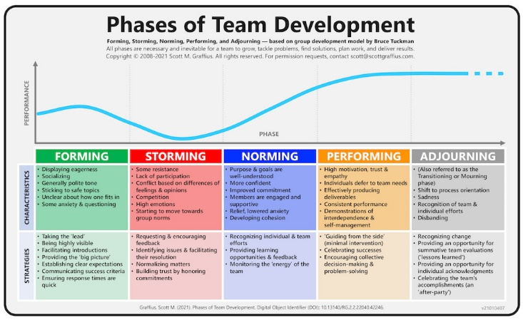

Slide 8
Characteristics of
Effective Teams
Effective teams have a clear sense of purpose, communicate openly and honestly, reach decisions by consensus, think creatively, remain focused, and resolve conflict effectively. The purpose of developing an effective team is to get members to collaborate on necessary tasks, and much of that collaboration takes place in meetings.

Slide 9
Resolving Team Conflict
Teams and individuals may believe they are competing for scarce or declining resources, such as money, information, and supplies. Team members may disagree about who is responsible for a specific task (usually the result of poorly defined responsibilities and job boundaries). Poor communication can lead to misunderstandings and withholding information can undermine trust. Basic differences in values, attitudes, and personalities may lead to arguments. Power struggles may result when one party questions the authority of another or when people or teams with limited authority attempt to increase their power or exert more influence. Conflict can also arise because individuals or teams are pursuing different goals.

Slide 10
Types of Conflict
Constructive
Destructive
Exposes Issues
Diverts Energy
Boosts Involvement
Destroys Morale
Generates Ideas
Divides the Team
Notes:
Conflict can be both constructive and destructive. Conflict is constructive if it forces important issues into the open, increases involvement of team members, and generates creative solutions. Conflict is destructive if it diverts energy from more important issues, destroys the morale of teams or individual team members, or polarizes or divides the team.

Slide 11
Types of Conflict
Conflict can be both constructive and destructive. Conflict is constructive if it forces important issues into the open, increases involvement of team members, and generates creative solutions. Conflict is destructive if it diverts energy from more important issues, destroys the morale of teams or individual team members, or polarizes or divides the team.

Slide 12
Resolving Conflict
Proaction
Fairness
Research
Communication
Alliance
Flexibility
Openness
Notes:
One of the first steps to finding a win-win solution is to preserve the “you” attitude by considering the other person’s needs and searching for mutually satisfactory solutions or compromises. The following seven measures that can help team members successfully resolve conflict:
Proaction. Deal with minor conflict before it becomes major conflict.
Communication. Get those directly involved in the conflict to participate in resolving it.
Openness. Get feelings out in the open; then deal with the main issues.
Research. Seek factual reasons for the problem before seeking solutions.
Flexibility. Don’t let anyone lock into a position before considering other solutions.
Fair play. Don’t avoid a fair solution by hiding behind the rules.
Alliance. Get parties to fight together against an “outside force” instead of against each other.

Slide 13
Conflict Management
Proaction. Deal with minor conflict before it becomes major conflict.
Communication. Get those directly involved in the conflict to participate in resolving it.
Openness. Get feelings out in the open; then deal with the main issues.
Research. Seek factual reasons for the problem before seeking solutions.
Flexibility. Don’t let anyone lock into a position before considering other solutions.
Fair play. Don’t avoid a fair solution by hiding behind the rules.
Alliance. Get parties to fight together against an “outside force” instead of against each other.

Slide 14
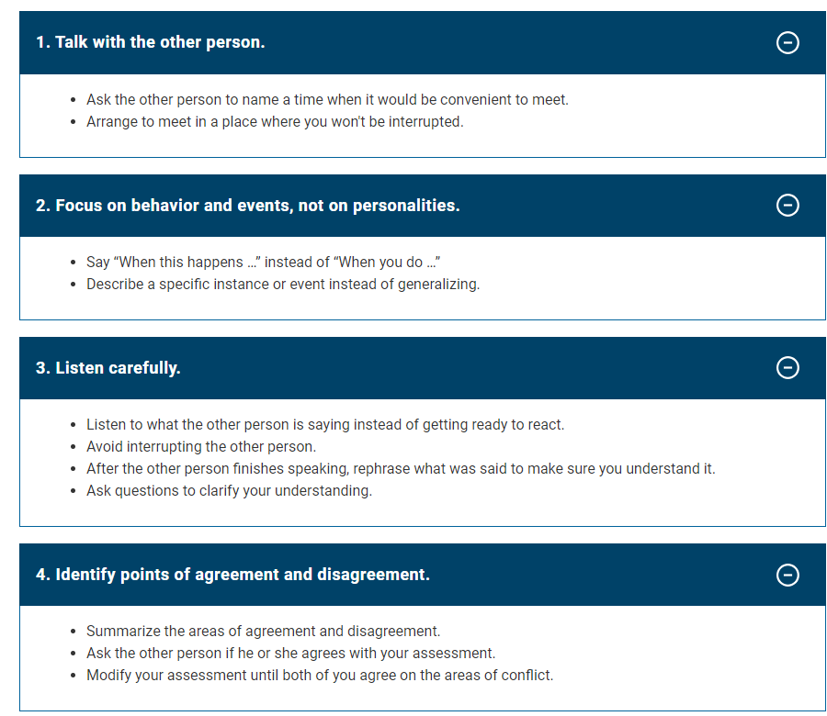

Slide 15
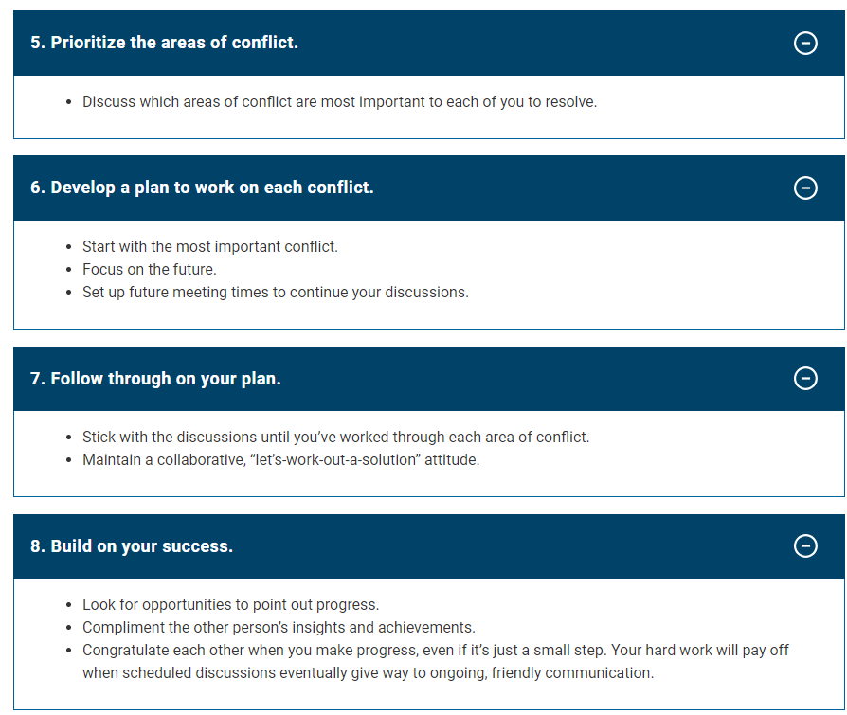

Slide 16

Preparing for Meetings
Purpose
Participants
Agenda
Location
Notes:
The key to productive meetings is careful planning of purpose, participants, location, and agenda.
Decide on your purpose. In informational meetings, participants share information and sometimes coordinate action. Briefings may come from each participant or from the leader. In decision-making meetings participants persuade, analyze, and solve problems. They are often involved in brainstorming sessions and debates.
Select participants. Try to invite only those people whose presence is essential. If the session is purely informational and one person will be doing most of the talking, you can include a relatively large group. However, if you’re trying to solve a problem, develop a plan, or reach a decision, try to limit participation to between 6 and 12 people.
Choose an appropriate location. Decide where you’ll hold the meeting, and reserve the location. Also, consider the seating arrangements.
Set and follow an agenda. Meeting agendas help prepare the participants. Distribute the agenda to participants several days before the meeting so that they know what to expect and can be prepared.

Slide 17
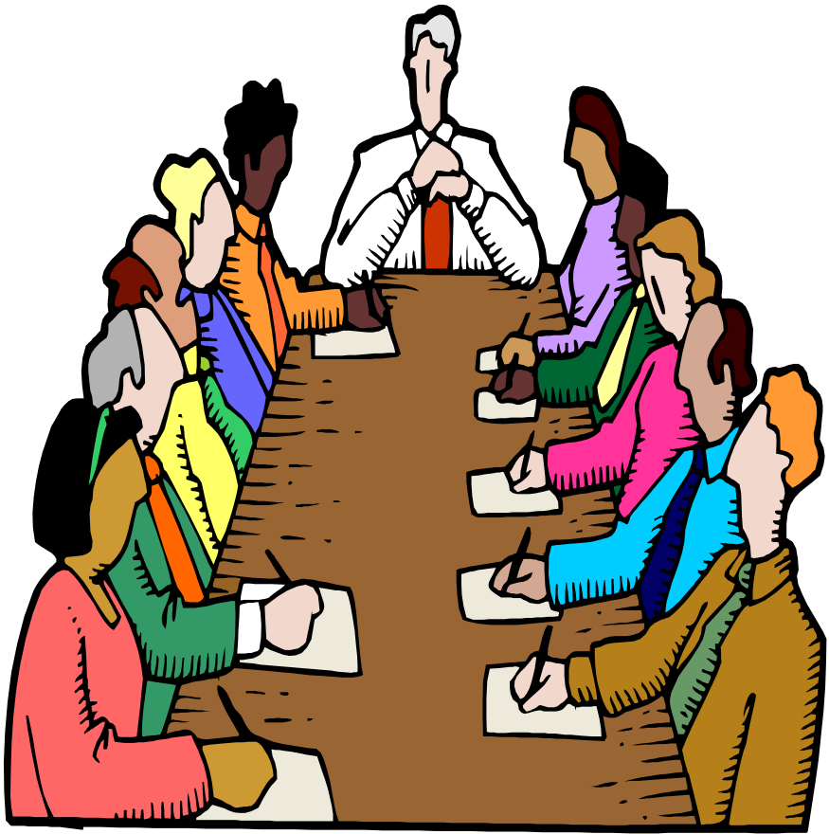
Leading and Participating
Stay on track
Follow the rules
Promote participation
Participate actively
Close effectively
Follow up
Notes:
Everyone in a meeting shares the responsibility for keeping the meeting productive and making it successful. If you're the designated leader of a meeting, however, you have an extra degree of responsibility and accountability. To ensure productive meetings, be sure to do the following:
Keep the meeting on track. The leader is responsible for keeping the meeting moving along and pacing the presentation and discussion according to the agenda. However, the leader must allow enough time for all the main ideas to be heard, and give people a chance to raise related issues.
Follow agreed-upon rules. One way a leader can improve the productivity of a meeting is by using parliamentary procedure, a time-tested method for planning and running effective meetings. The basic principles of parliamentary procedure can help teams to transact business efficiently, protect individual rights, maintain order, preserve a spirit of harmony, and accomplish team and organizational goals.
Encourage participation. Some participants are too quiet and others are too talkative. The best meetings are those in which everyone participates, so a leader must not let one or two people dominate the meeting while others doodle on their notepads.
Participate actively. If you’re a meeting participant, try to contribute to both the subject of the meeting and the smooth interaction of the participants. Speak up if you have something useful to say, but don’t monopolize the discussion.
Close effectively. At the end of the meeting, the leader should summarize the discussion or list the actions to be taken and specify who will take them and when. Wrapping things up ensures that all participants agree on the outcome and gives people a chance to clear up any misunderstandings.

Slide 18
Leading and Participating
Everyone in a meeting shares the responsibility for keeping the meeting productive and making it successful. If you're the designated leader of a meeting, however, you have an extra degree of responsibility and accountability. To ensure productive meetings, be sure to do the following:
Keep the meeting on track. The leader is responsible for keeping the meeting moving along and pacing the presentation and discussion according to the agenda. However, the leader must allow enough time for all the main ideas to be heard, and give people a chance to raise related issues.
Follow agreed-upon rules. One way a leader can improve the productivity of a meeting is by using parliamentary procedure, a time-tested method for planning and running effective meetings. The basic principles of parliamentary procedure can help teams to transact business efficiently, protect individual rights, maintain order, preserve a spirit of harmony, and accomplish team and organizational goals.
Encourage participation. Some participants are too quiet and others are too talkative. The best meetings are those in which everyone participates, so a leader must not let one or two people dominate the meeting while others doodle on their notepads.
Participate actively. If you’re a meeting participant, try to contribute to both the subject of the meeting and the smooth interaction of the participants. Speak up if you have something useful to say, but don’t monopolize the discussion.
Close effectively. At the end of the meeting, the leader should summarize the discussion or list the actions to be taken and specify who will take them and when. Wrapping things up ensures that all participants agree on the outcome and gives people a chance to clear up any misunderstandings.

Slide 19
Facts about corporate culture
Your worth to the company and its people is tied to your last performance rating/evaluation.
People are nice to you only when you are influential or they need you. Once the need or influence changes, so does their behavior.
Promotions are not linked to performance. At best they are linked to the perception of your performance.
When you are the star, most mistakes are forgiven.
Know when to speak up and disagree with senior management.
There will be times when you have to choose between being in the right or being employed.
Never associate your self-worth to your position and performance in the company.
Always create a strong network

Slide 20
Lets test your learning
Suppose you want to communicate in the team for your bus com report. What strategy should you take to make it an effective?

